Slide 1

University Of Buea
Faculty of Engineering And Technology.
CEF440
Internet Programming and Mobile Programming
Task2

Slide 2
Instructor: Dr Nkemeni Valery
Presented By..
Name Of Student | Matriculation Number
IHIMBRU ZADOLF ONGUM | FE21A203
FONJI DANIEL KUKUH | FE21A194
NFOUA EUGENE MGBA | FE21A257
EPIE MUKEH SANDRA | FE21A185
CHE KASSINA KUM | FE21A158

Slide 3
REQUIREMENTS GATHERING
BIOMETRIC STUDENT ATTENDANCE MOBILE APPLICATION

Slide 4
OUTLINE
Understanding the project scope and objectives.
Identifying key stakeholders and their requirements.
System requirement gathering specifications
Documenting functional and non-functional requirements.
Conducting interviews and surveys to gather information.
Conclusion.

Slide 5
INTRODUCTION
To combat these challenges, there's a rising interest in adopting biometric class attendance registers, leveraging technologies like fingerprint or facial recognition for automated and real-time tracking.
In the contemporary educational realm, the necessity for precise and efficient attendance tracking systems is increasingly apparent. Conventional methods like manual paper-based or basic digital systems often encounter issues such as inaccuracies, delays, and inefficiencies.

Slide 6
Overview
The Biometric Class Attendance Register project aims to modernize and streamline the process of tracking student attendance in educational institutions using biometric technology.
Aim to improve accuracy, efficiency, and security.
Reducing administrative burden and potential errors associated with manual attendance tracking methods.

Slide 7

Defining the Project scope
Objectives:
Automate Attendance Tracking
Enhance Accuracy and Reliability
Improve Efficiency
Ensure Data Security and Privacy
Facilitate Integration

Slide 8
Stakeholder identification
Stakeholder analysis is a crucial step in understanding the needs, requirements, and expectations of those who will be affected by or involved in the development and implementation of a biometric class attendance register.
Teachers
Students
Administrators
Role: Teachers are the primary users responsible for taking attendance during classes.
Responsibilities: Taking attendance, monitoring attendance patterns, reporting.
Role: Students are the end-users who interact with the attendance system to register their presence in class.
Responsibilities: Registering attendance, compliance.
Role: Administrators oversee data management, reporting, and system administration related to attendance tracking.
Responsibilities: Data management, reporting, system administration.

Slide 9

Conducting interviews and surveys
Conducting interviews and surveys for a biometric attendance system is crucial for gathering insights from stakeholders. Through interviews, key individuals such as teachers, administrative staff, and students can provide valuable input on their needs, concerns, and preferences regarding the system.

Slide 10
Stakeholder expectations from Conducting interviews and surveys
Administrator
Acknowledge the necessity of integration while recognizing its current infeasibility.
Ensure transparency in system operations and processes.
Establish mechanisms to promptly respond to errors
Explore the possibility of offline functionality to enhance usability.
Determine that data security is not a primary concern for the system.

Slide 11
Stakeholder expectations from Conducting interviews and surveys
Lecturers
Enable lecturers to activate attendance easily.
Ensure reliability and accuracy of the attendance system.
Require registration for both students and lecturers.
Consider handling unknown cases effectively.
Provide real-time updates on attendance.
Address the handling of carryover students
Manage situations where students are present in class but fail to register within the activation time limit.
Establish procedures for handling late arrivals in the attendance system.
Generate attendance lists automatically after each session.

Slide 12
Stakeholder expectations from Conducting interviews and surveys
Students
Implement a more efficient attendance recording.
Address challenges associated with the current attendance tracking system, such as time-consuming processes, inaccuracies.
Explore the potential of implementing a biometric attendance system as an alternative solution.
Address concerns regarding the privacy and security of the system.
Assess the potential impact of a biometric attendance system on reducing attendance fraud or proxy attendance.

Slide 13
Brainstorming
Improve attendance tracking efficiency and accuracy.
Enhance user experience for both lecturers and students.
Increase transparency and accountability in attendance management processes.
Ensure reliability and integrity of attendance data.
Enable real-time access to attendance information.
.

Slide 14
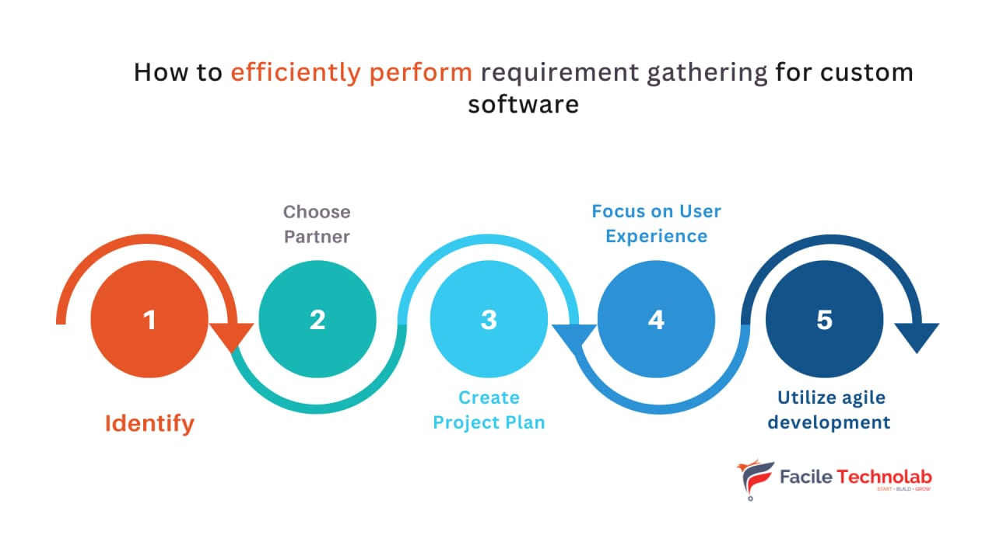
Research and background investigation
Assessing Biometric Technology
Evaluation of Biometric Modalities
Consideration of practicality and suitability

Slide 15
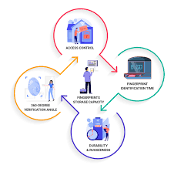
USER EXPERIENCE REQUIREMENTS
Intuitive Interface
Mobile Compatibility
System should be easy and transparent
System should be fast and easy for all users.

Slide 16
SYSTEM REQUIREMENTS GATHERING
Hardware Requirements
Biometric Devices
Server Infrastructure
Network Infrastructure
Software Requirements
Operating System
Database Management System (DBMS)

Slide 17
FUNCTIONAL REQUIREMENTS GATHERING
Biometric Data Capture
Real-time Tracking
Integration
Reporting

Slide 18
NON-FUNCTIONAL REQUIREMENTS GATHERING
Legal and Ethical Considerations
Obtaining Informed Consent
Implementation of Robust Security Measures
Performance Objectives
Primary Goals
Considering Compliance and Security
GDPR Compliance
Secure Storage
Scalability
Designing the system to handle varying class sizes and accommodate future growth without compromising performance

Slide 19
CONCLUSION
Thorough requirement gathering is required for a biometric class attendance system, which involves analyzing stakeholder needs, existing processes, and technological factors. This process lays the groundwork for designing and implementing an efficient and secure solution that meets the specific needs of educational institutions.

Slide 20
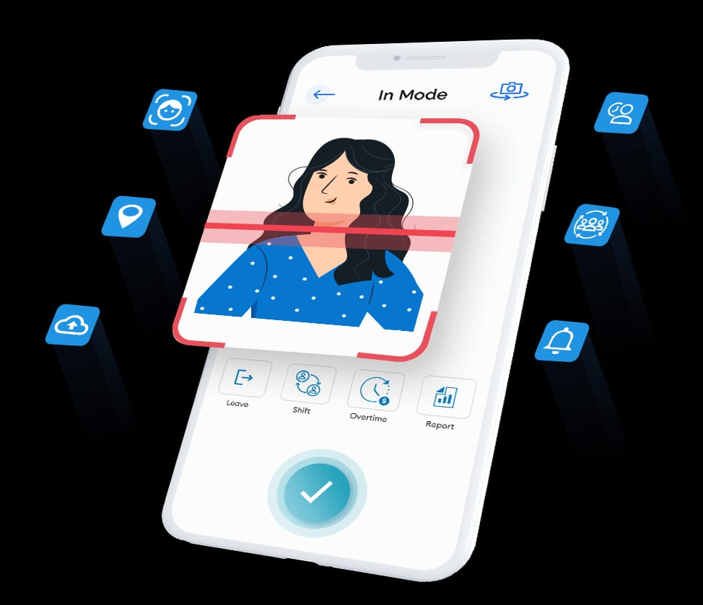
THANKS FOR YOUR ATTENTION

